Slide 1

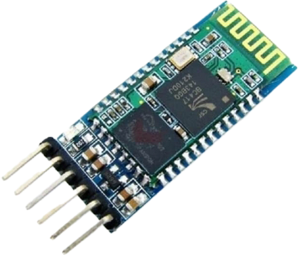
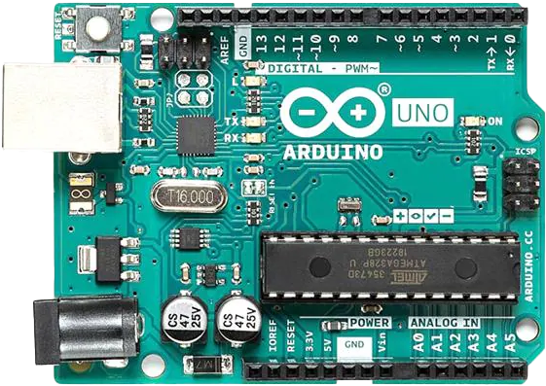

+
=
When HC-05 (Bluetooth) met Arduino
Iordanis Kostelidis, Chair of IEEE IHU Student Branch (Serres)

Slide 2


Speaker
A short bio
Iordanis Kostelidis
International Hellenic University
BEng in Informatics Engineering, 2013-2024
Software Engineering
(waiting for graduation ceremony in May)
IEEE
Student Member, 2015-2024
(waiting for elevation to Member)
IEEE IHU Student Branch (Serres)
Chair of SB, 2019-2022, 2024-2025
DataScouting
Software Engineer, 2018-2023, 2024-???

Slide 3
IEEE
What is it?
The world's largest technical professional organization dedicated to advancing technology for the benefit of humanity.
>450000 members
>170000 Student members
>180 countries

Slide 4
IEEE Strategic Plan
Greek Subtitles from IEEE SB University of Western Macedonia, Kastoria
https://www.youtube.com/watch?v=PefI0HKwoVQ
Το αρχείο με όνομα:
IEEE Strategic Plan_8763F700-C9C2-46A7-84C2-F44D8FAD5691

Slide 5
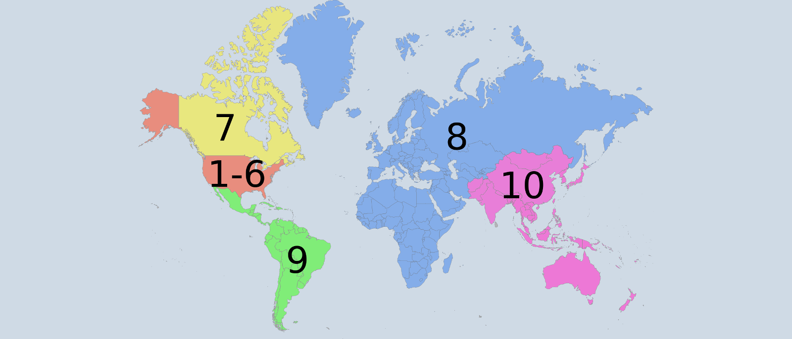
The Region 8
Our Region
Europe, Middle East and Africa

Slide 6
The Greece Section
The IEEE in our Country
>2000 members
One of the most active Sections in IEEE
20 Student Branches

Slide 7
IEEE IHU Student Branch
(es)
Two???
IEEE IHU Student Branch – Thessaloniki
Formerly, ATEI of Thessaloniki
Founded 2010
Subunits:
IEEE WIE Student Branch Affinity Group
IEEE IHU Student Branch – Serres
Formerly, TEI of Central Macedonia
Formerly, TEI of Serres
Founded 2011
Subunits:
IEEE WIE Student Branch Affinity Group
IEEE RAS Student Branch Chapter

Slide 8
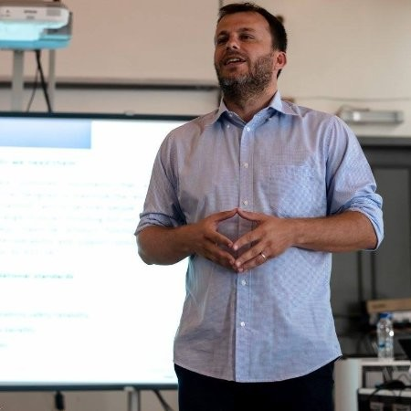
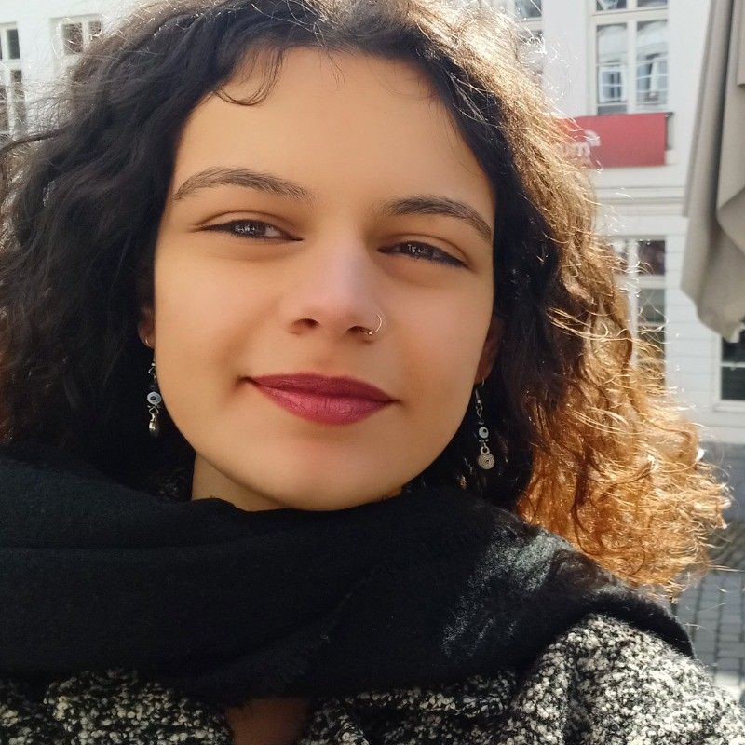
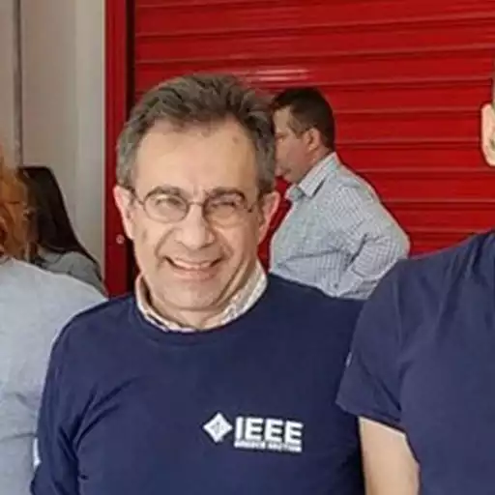

IEEE IHU Student Branch
(es)
Ex-Com(s)
IEEE IHU Student Branch (Thessaloniki)
Counselor
Periklis Chatzimisios
Chair
Chrysa Moulianitaki
IEEE IHU Student Branch (Serres)
Counselor
Dimitrios Efstathiou
Chair
Iordanis Kostelidis

Slide 9
IEEE IHU Student Branch (Serres)
Our Student Branch
Founded in 2011 (then as TEI of Serres) by students of the Department of Informatics, Computers and Communication Engineering, who wanted to do scientific research through the IEEE, participate in competitions and organize lectures for all students.
Awards:
3 IEEE R8 Exemplary Student Branch Award
2019, 2020, 2021
2nd Place at Better Life Challenge (by KOTSOVOLOS)
HERMES Team
As Cross-Student Branch Team with Members of
IEEE IHU RAS Student Branch Chapter (Serres)
IEEE UTh Student Branch (Volos)
Best Event and Best Ambassadors Award for WEI4H
Event: Cross-OUs (SBs, Section, AGs)
Best Ambassadors: Chrysoula Tsimperi (AUTh) and Christos Roumeliotis (UOWM),

Slide 10
IEEE IHU Student Branch (Serres)
Projects, Events and Activities
A Bluetooth Based Traffic Light Time Extension System for Pedestrians with Disabilities
First Implementation:
2018, IEEE ComSoc Student Competition 2018
Second Implementation:
2019, Paper Presented at SEEDA-CECNSM 2019
HERMES Team
2018
Hellenic Robotic Modular Exoskeleton System
Cross-Student Branch Project
IEEE IHU RAS Student Branch (Serres)
IEEE UTh Student Branch (Volos)

Slide 11
IEEE IHU Student Branch (Serres)
Projects, Events and Activities
IEEEDay
IEEEXtreme
IEEEMadC
Google HashCode
Arduino Day

Slide 12
IEEE IHU Student Branch (Serres)
Projects, Events and Activities
IEEE HSYP and R8SYP
HSYP – Athens, 2017
R8SYP – Porto, 2018
HSYP – Xanthi, 2019
vR8SYP – 2020
vHSYP – 2021
R8SYP – Tunis, 2022
R8SYP – Grenoble, 2024 (Future)

Slide 13
IEEE IHU Student Branch (Serres)
Projects, Events and Activities
IEEE Region 8 Entrepreneurship Week
Innovation for Health (WEI4H)
Co-Organized with
IEEE AUTh SB, IEEE UOWM SB – Kozani, IEEE UTh SB - Lamia, IEEE Region 8, IEEE Greece Section, IEEE YP Greece Section Affinity Group, IEEE WIE Greece Section Affinity Group, IEEE EMB Greece Section Chapter
Smart Internet of Things for Energy Systems (SIOT4ES)
Co-Organized by
IEEE IHU SB - Thessaloniki, IEEE AUTh SB, IEEE UTh SB – Volos, IEEE UTh – Lamia, IEEE NTUA SB, IEEE UOC SB, IEEE ComSoc Greece Section Chapter, IEEE YP Greece Section Affinity Group

Slide 14
IEEE IHU Student Branch (Serres)
Projects, Events and Activities
ECESCON
11 – Thessaloniki, 2019
13 – Patra, 2022
14 – Volos, 2023
And………..

Slide 15
IEEE IHU Student Branch (Serres)
Projects, Events and Activities

Slide 16
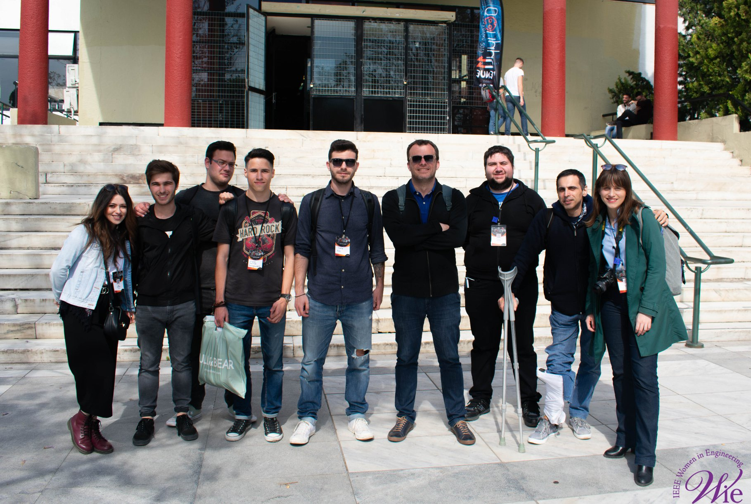
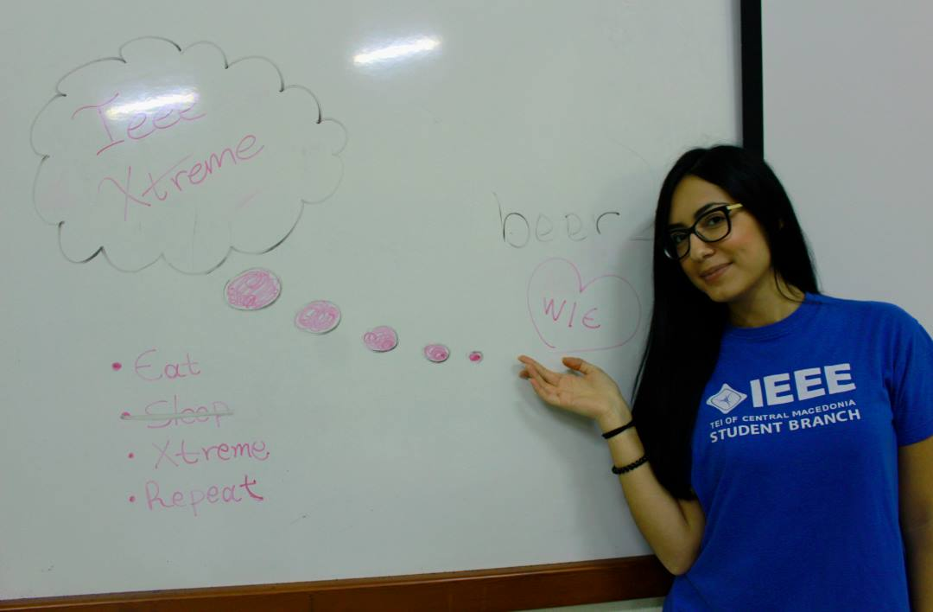
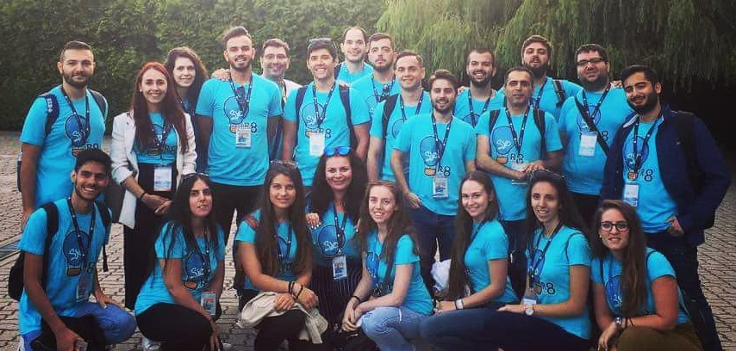
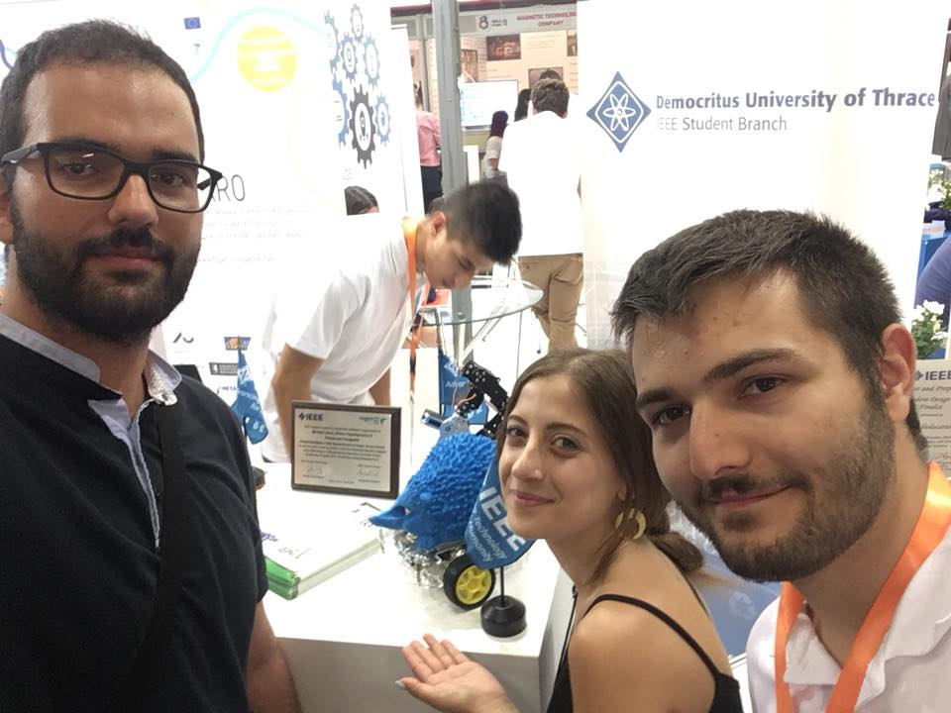
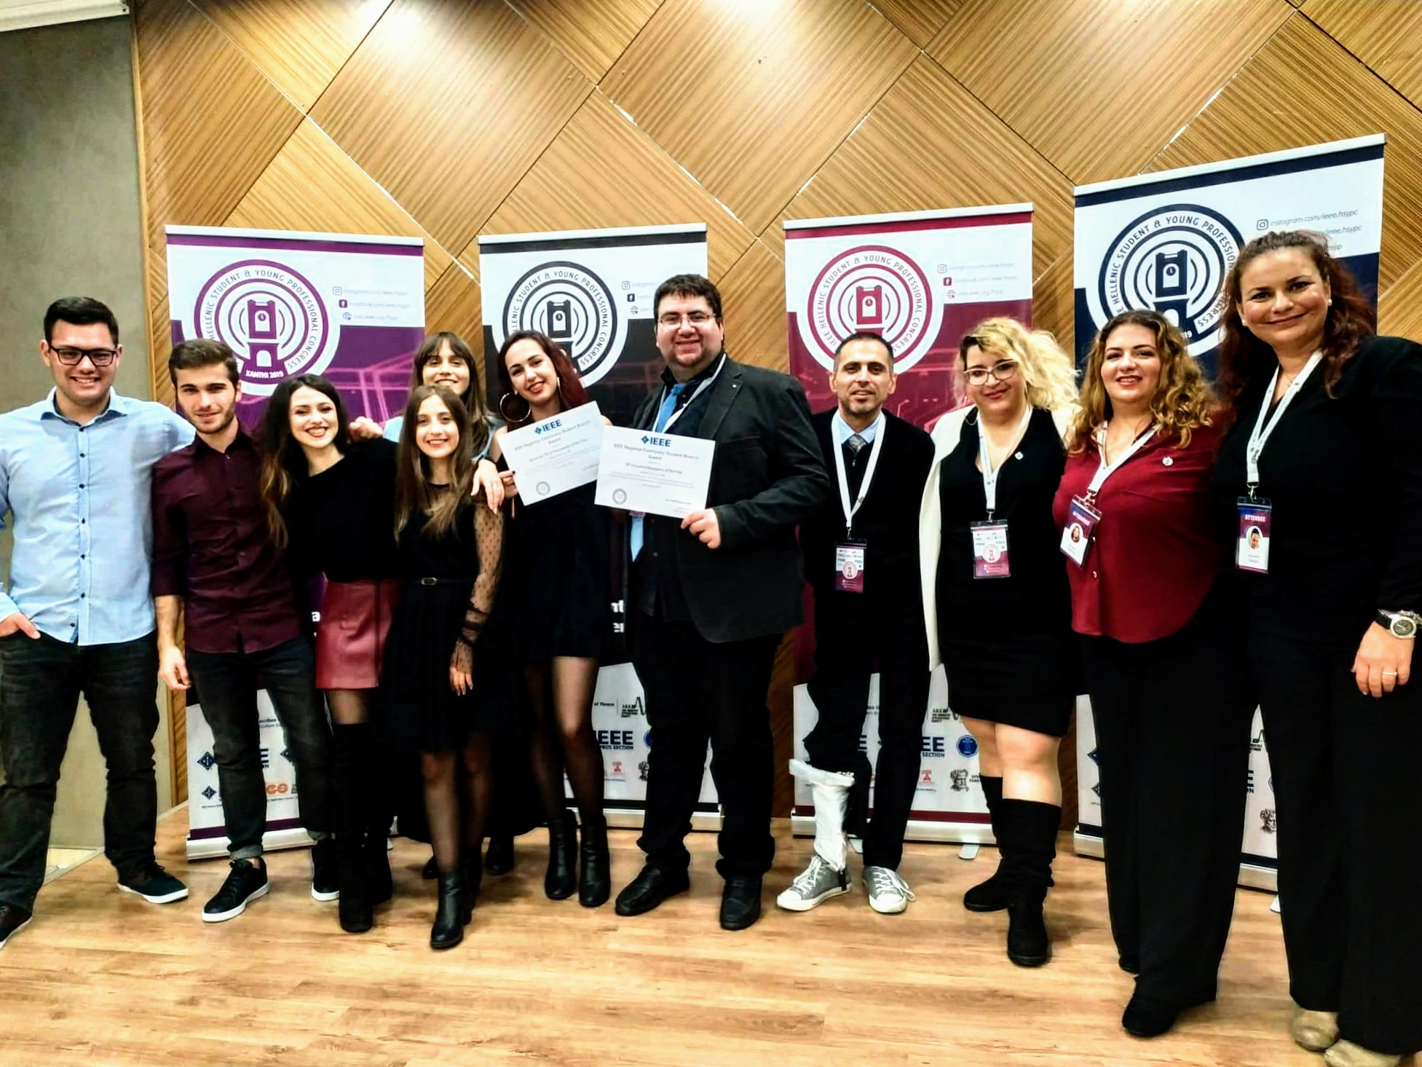
IEEE IHU Student Branch (Serres)
Photos

Slide 17
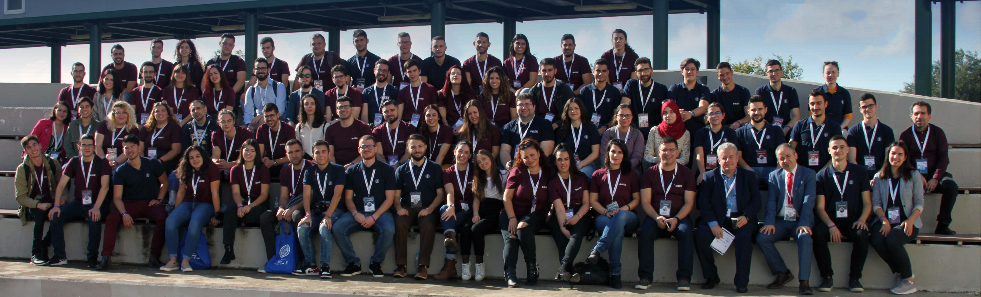
IEEE IHU Student Branch (Serres)
Photos

Slide 18
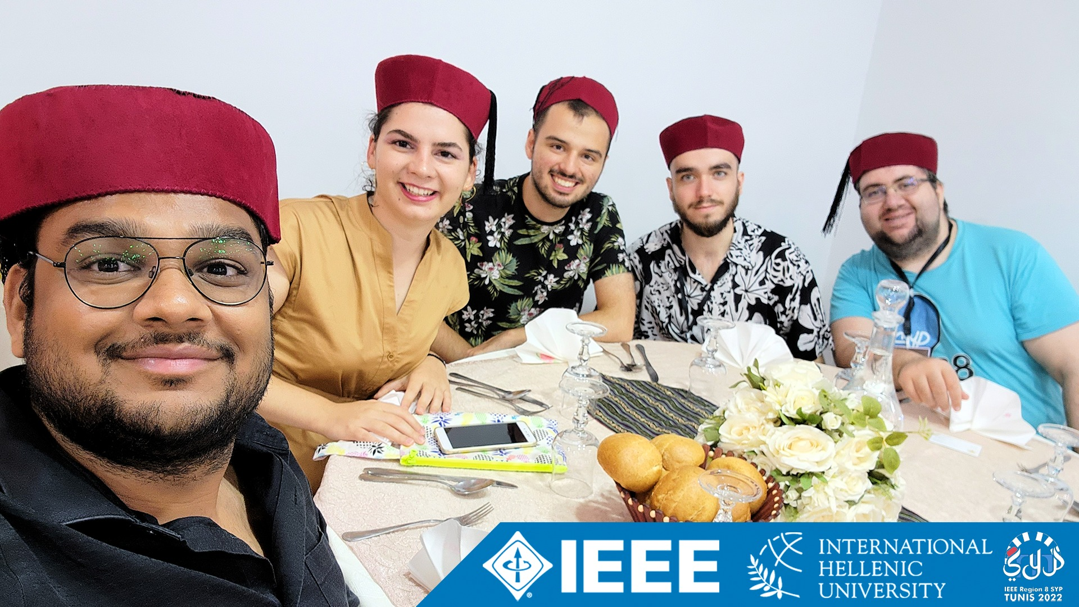
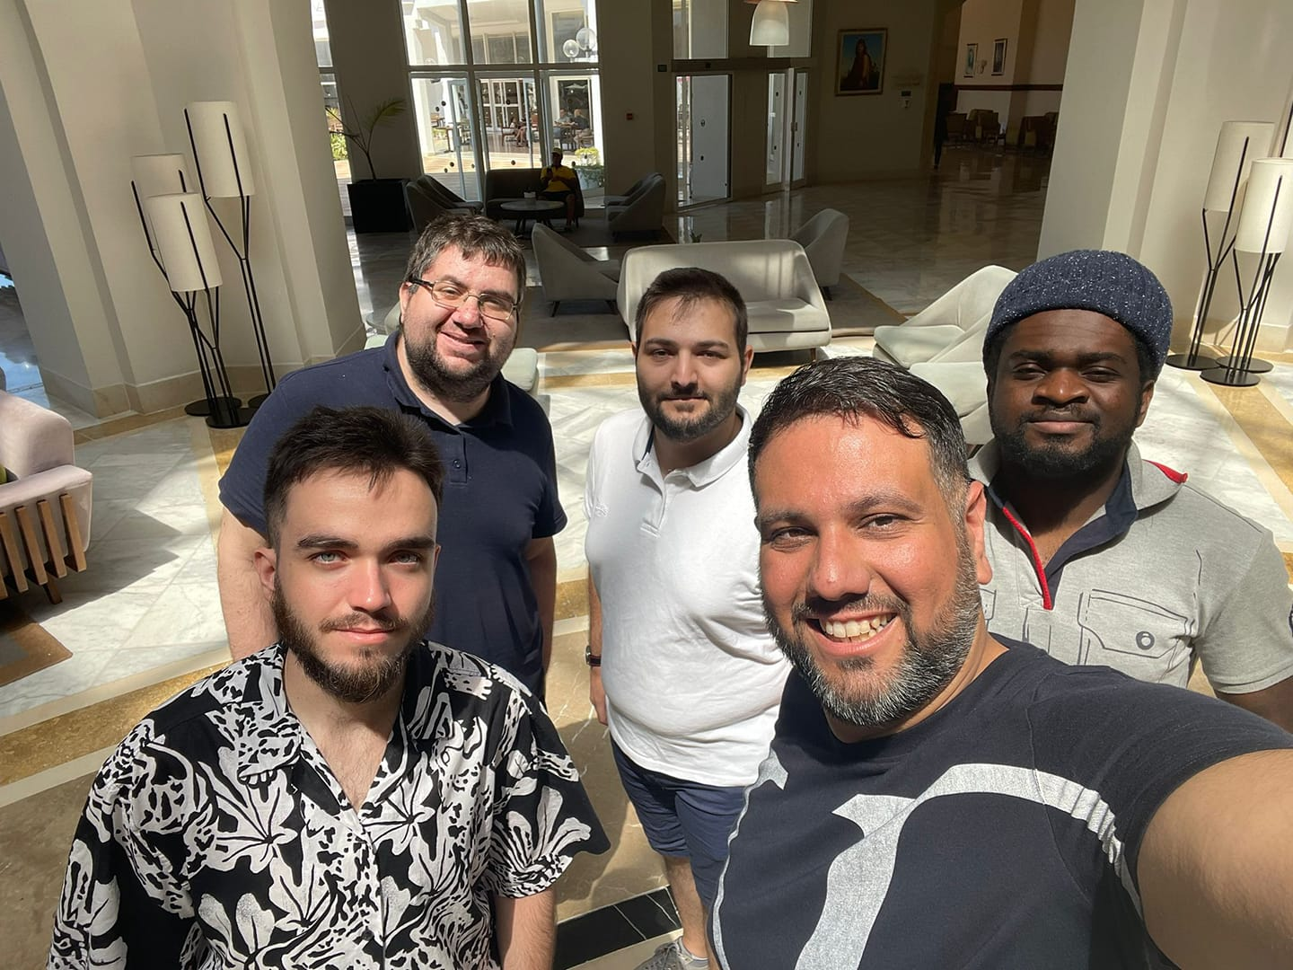
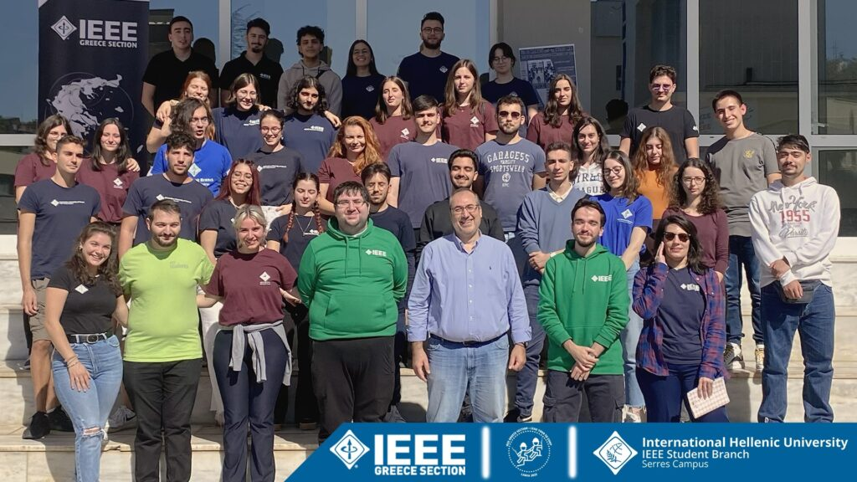
IEEE IHU Student Branch (Serres)
Photos

Slide 19
A Bluetooth Traffic Light Time Extension System for Pedestrians with Disabilities
Our Paper
A new and simple approach to traffic lights crosswalk time extension. It uses a seamless integration to conventional traffic lights based on low cost components and micro controllers. The goal of the presented project is to provide extra time to a pedestrian or a group of pedestrians with disabilities to pass a crosswalk.

Slide 20
A Bluetooth Traffic Light Time Extension System for Pedestrians with Disabilities
Please, don’t laugh…

Slide 21
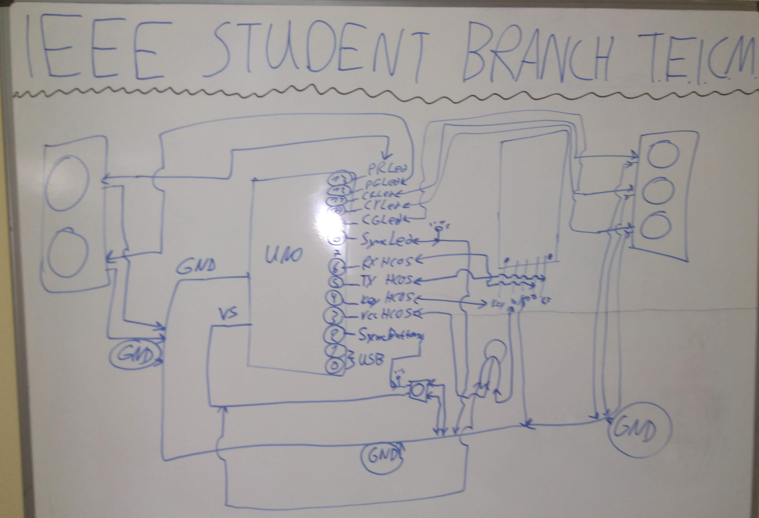
A Bluetooth Traffic Light Time Extension System for Pedestrians with Disabilities
Our Prototype (Design)

Slide 22
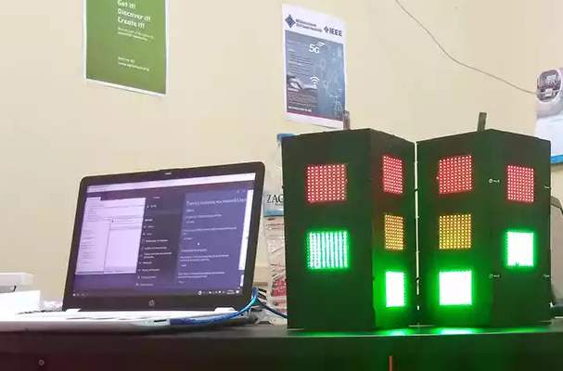
A Bluetooth Traffic Light Time Extension System for Pedestrians with Disabilities
Our Prototype (Implemented)

Slide 23
Proof of Concept
Test Case
Το αρχείο με όνομα:
A Bluetooth Traffic Light Time Extension System for Pedestrians with disabilities_B800F4EC-4D86-4ED7-9AE6-9BC6EC30BE47

Slide 24
Arduino (Uno)
What is Arduino?
Open-Source Electronics Platform
Microcontroller
Digital and Analog IO pins
C/C++-Like Programming Language
Wiring

Slide 25
HC-05
What is this?
Bluetooth 2.0+EDR
Serial Bluetooth module for Arduino
Operating Voltage: 4V to 6V (Typically +5V)
Operating Current: 30mA
Range: <100m
Follows IEEE 802.15.1 protocol
https://www.rajguruelectronics.com/ProductView?product=HC-05%20CORE%20MODULE&tokDatRef=NzA1&tokenId=NDA=

Slide 26
AT-09
What is this?
Bluetooth 4.0
Serial Bluetooth module for Arduino
Operating Voltage: 3.6-6V (Typically +5V)
Operating Current: 90-400mA
Range: <100m
https://robu.in/product/at-09-bluetooth-4-0-uart-transceiver-module-cc2541-compatible-with-hm-10/

Slide 27
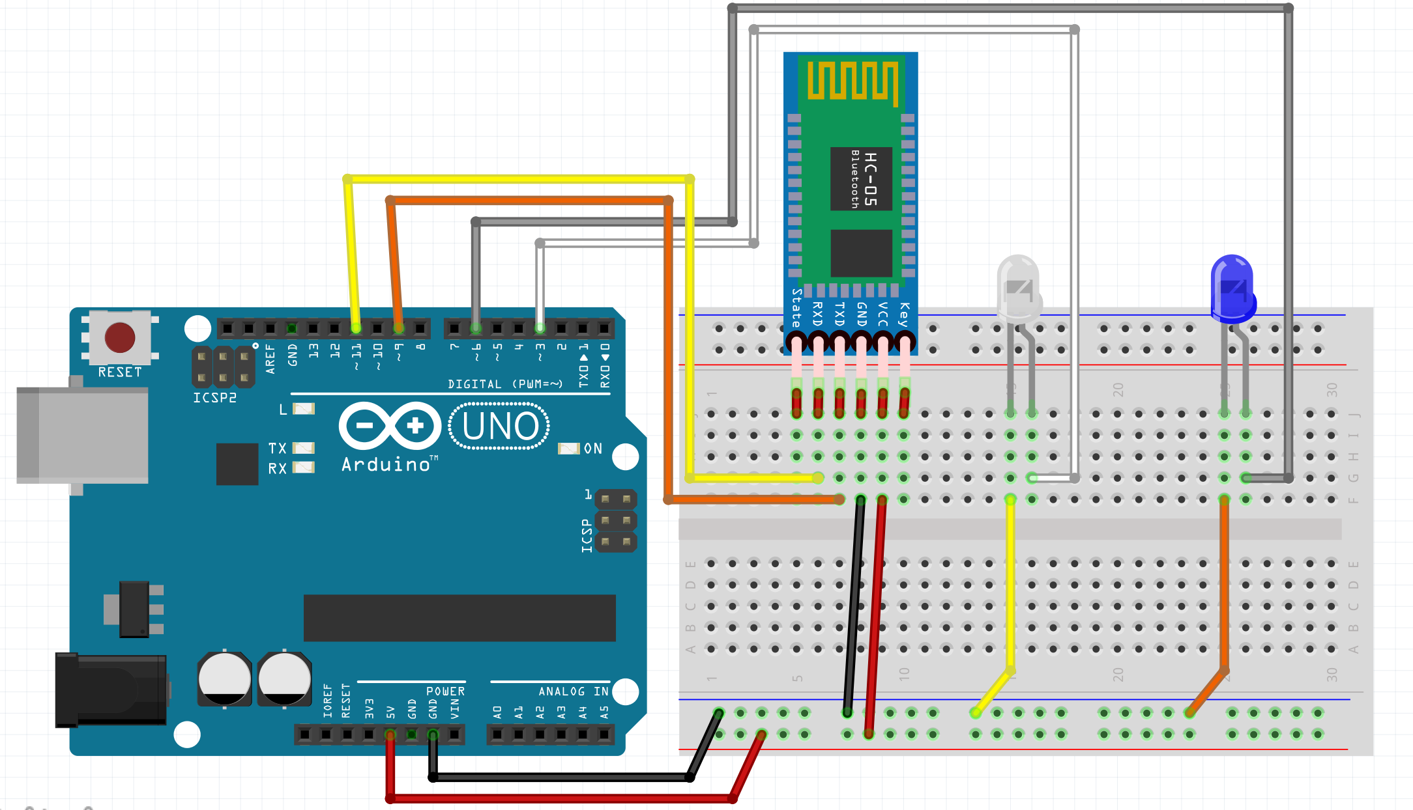
Let’s Create an Arduino Project with Bluetooth
Powered by HC-05 (and AT-09)

Slide 28
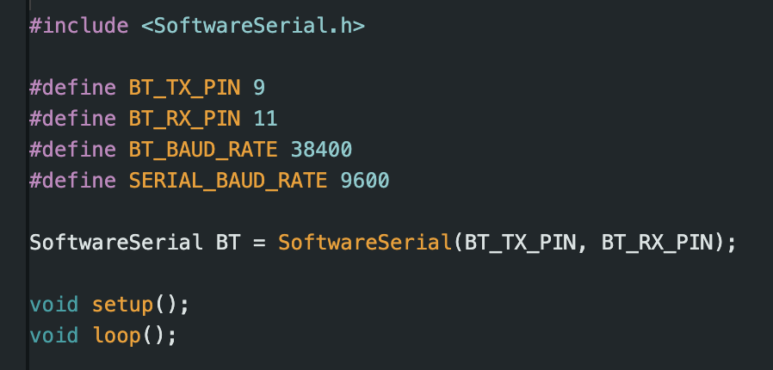
Let’s Create an Arduino Project with Bluetooth
Sample Code for HC-05

Slide 29
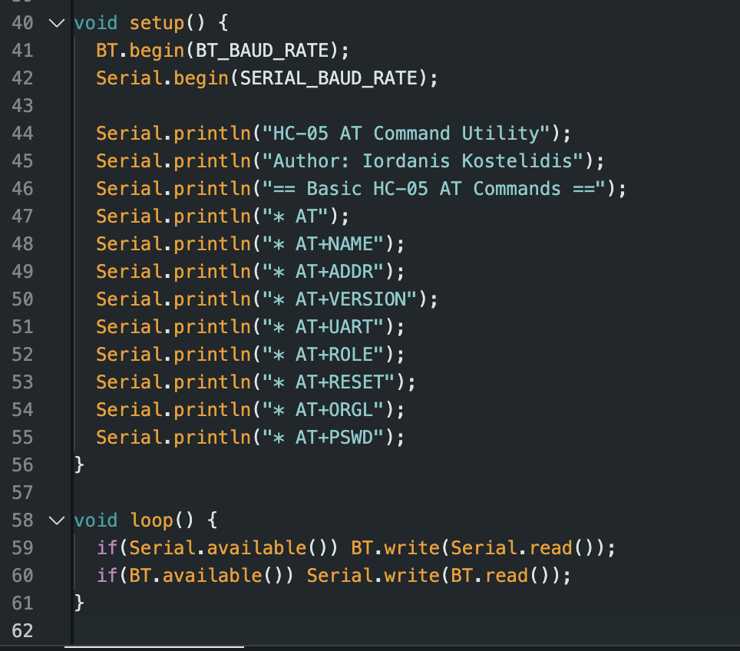
Let’s Create an Arduino Project with Bluetooth
Sample Code for HC-05

Slide 30
Let’s Create an Arduino Project with Bluetooth
Let’s Open Arduino IDE and “deploy” some code…

Slide 31

Questions???
Just Ask

Slide 32
Workshop Material
Slides, Design and Codes
https://ecescon15.ieeeihuserres.org

Slide 33
Contact
With SBs or/and Me!
IEEE IHU Student Branch (Thessaloniki)
https://ieee.iee.ihu.gr
IEEE IHU Student Branch (Serres)
https://ieeeihuserres.org
sb.ihu.serres@ieee.org
Iordanis Kostelidis
https://kostelidis.dev
https://orcid.kostelidis.dev
ikostelidis@kostelidis.dev
For IEEE-related messages only:
kostelidis@ieee.org

Slide 34

That’s all folks
It’s over….

